Slide 1
Speed Control of DC motor

Slide 2
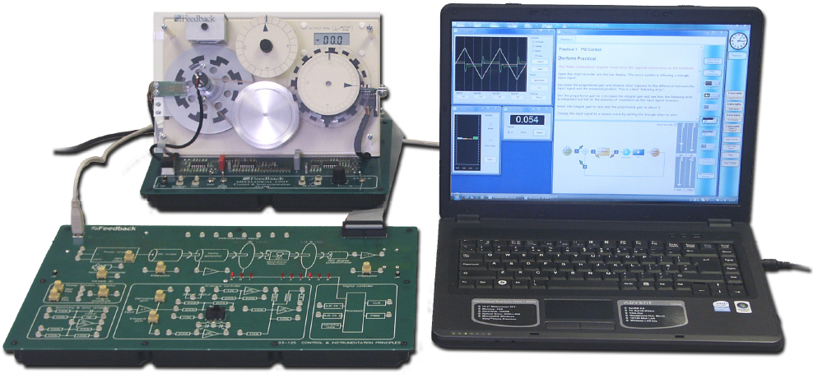
Experimental Set-up

Slide 3
Motor Connection Diagram
15V DC Motor
Motor speed controlled by the PWM signal which is generated by the Micro-Controller at one of its digital output port pin.
The PWM signal essentially controls the On/Off state of the transistor, allowing the input current to flow through the motor or block it.
Motor
Diode
+
20V
Transistor
PWM Signal

Slide 4
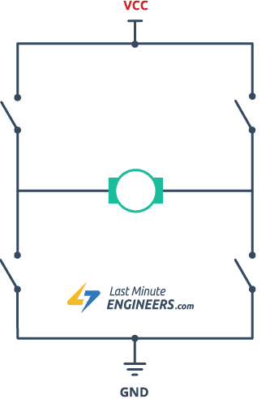
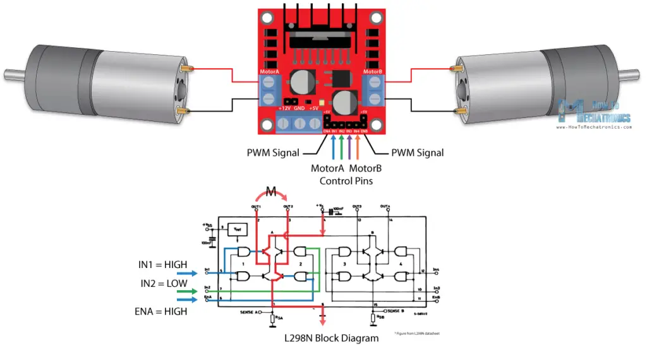
H-bridge and LM298N motor driver

Slide 5
Sensors for Mechatronics System
• Internal sensors (Dead-reckoning)
Speed measurement – Tacho-generator, encoder
Current measurement
– Wheel Encoders, Odometry
– Accelerometers (spring-mounted masses)
– Gyroscopes (spinning mass, laser light)
– Compasses, inclinometers (earth magnetic field, gravity)
• Proximity sensors
– Ultrasound
– Sonar (time of flight) [SOund Navigation And Ranging]
– Radar (phase and frequency) [RAdio Detection And Ranging]
– LIDAR, Laser range-finders (triangulation, ToF, phase) [LIght Detection And Ranging]
– Infrared (intensity)
• Visual sensors: Cameras
• Satellite-based sensors: GPS

Slide 6
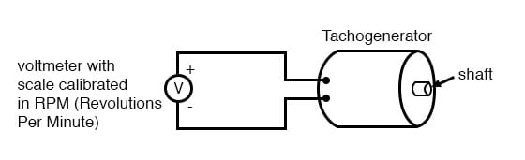
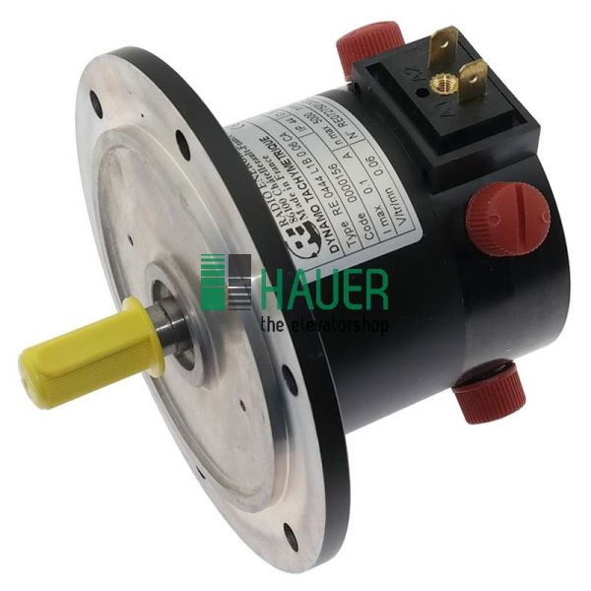
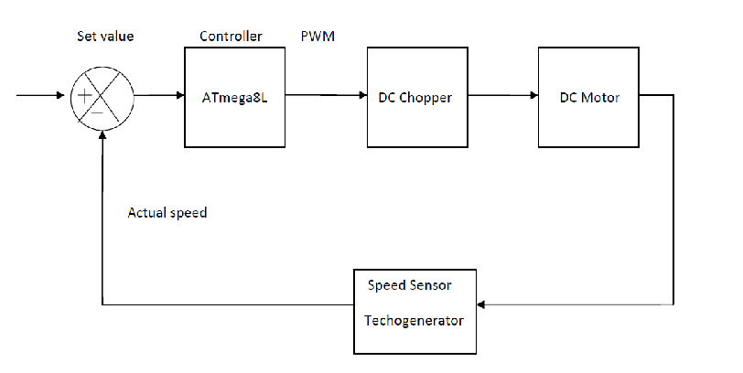
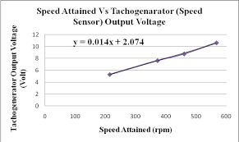
Tacho-generator

Slide 7
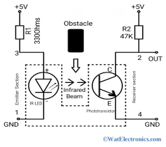
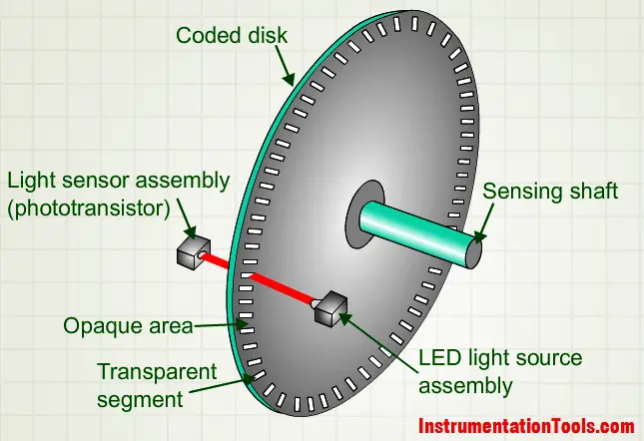
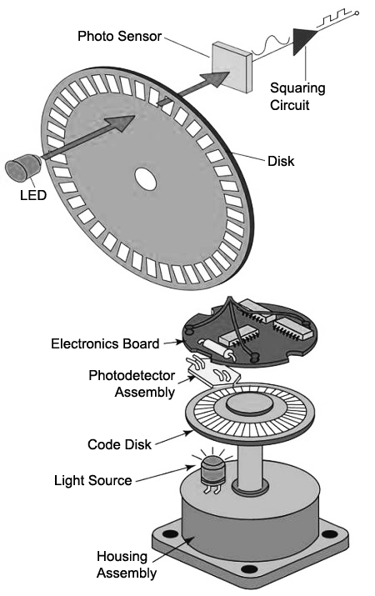
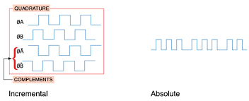
Encoder

Slide 8
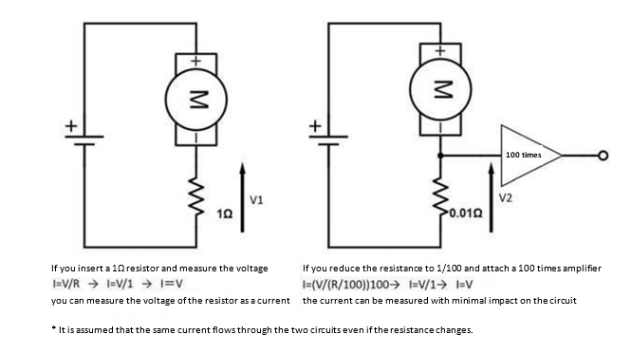
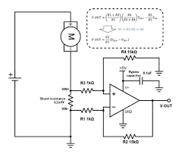
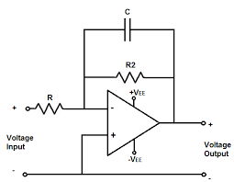
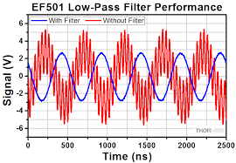
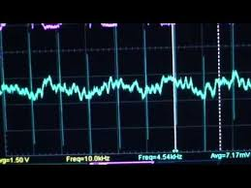
Current measurement of DC motor

Slide 9
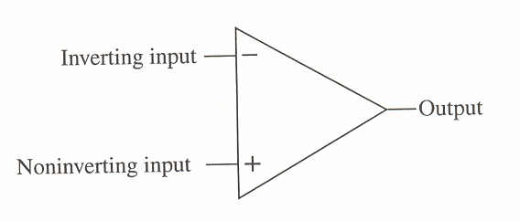
The operational amplifier (Op-amp)
Processing of Sensor signals
Differential voltage gain, Ad: the amplification of the op-amp of the difference between the two inputs, also known as the open loop gain
In a good amplifier the voltage gain should be as high as possible.
Gains of 10⁶ or higher are common.
An ideal amplifier should have an infinite gain.

Slide 10
Basic Opamp Configuration
Voltage Comparator
digitize input
Voltage Follower
buffer
Non-Inverting Amp
Inverting Amp

Slide 11
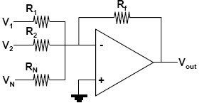
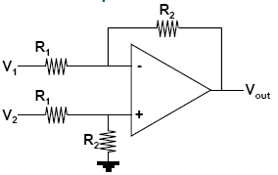
More Opamp Configurations
Summing Amp
Differential Amp
Integrating Amp
Differentiating Amp

Slide 12
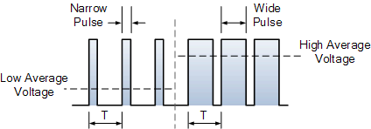
Speed Control using Pulse Width Modulation (PWM)
Used for efficient DC motor speed control.
A PWM circuit works by generating a square wave with a variable on-to-off ratio.
The average ‘on’ time may be varied from zero to 100%.
A variable amount of voltage is applied across the motor, thus power is transferred to the load (motor).

Slide 13
Speed Control using Pulse Width Modulation (PWM)
The high value is held during a variable pulse width t during the fixed period T (Frequency = 1/T)
The resulting waveform has a duty ratio (or duty cycle), defined as the ratio between the ON time and the period of the waveform, usually specified as a percentage.
In PWM control, the voltage is switching rapidly across the armature
fixed period and amplitude (peak value)
variable duty cycle
However, due to the motor inductance and resistance, the resulting current through the motor has a small fluctuation around an average value.
As the duty cycle gets larger, the average voltage gets larger and the motor speed increases.

Slide 14
Generating PWM Signal
Use Timer 0 in Auto-reload mode so that it overflows at a regular interval and generates an interrupt (software ‘tick’)
The PWM_Counter is incremented in the Timer 0 Interrupt Service Routine (ISR)
When the PWM_Counter value exceeds dutyCycleCount, the PWM_Output is reset to 0
When the PWM_Counter value exceeds MAX_count, the PWM_Output is set to 1 and PWM_Counter is re-initialized to 0
Duty Cycle can be changed by altering the value of dutyCycleCount

Slide 15
Timer 0 ISR
void Timer0_ISR (void) interrupt 1
{
TF0 = 0; //-- clear TF0 overflow flag
PWM_counter++;
if (PWM_counter >= dutyCycleCount)
PWM_output = 0;
if (PWM_counter >= MAX_Count)
{
PWM_output = 1;
PWM_counter = 0;
}
}
0 <= dutyCycleCount <= 256
Resolution of the duty cycle is 1/256 (approx. 0.39%).
PWM output is at one of the digital output port pin, example P0.4
The PWM output pin must be configured in push-pull mode.

Slide 16
PWM Frequency: Timer 0 reload value
For a desired PWM frequency, what should be the ‘tick time’ (Ttick)?
If T_{tick} = 10μs, then
Changing the value of T_{tick} will change the PWM frequency
To produce an interrupt at every 10 μs, what should be the reload value of Timer 0?

Slide 17
PWM Frequency: Timer 0 reload value
Using a System Clock of 22.1184 MHz-
Timer 0 reload value = 255 – 221 = 34

Slide 18
Varying the PWM Duty Cycle
The PWM ON time is changed by changing the value of dutyCycleCount, which must be between 0 and 255.
Use the potentiometer on the microcontroller development board which is connected to the Analog Input (AIN0.0) of ADC0.
The ADC0 output is a 12-bit data (0 to 4095).
In the program, read the ADC0 output and divide by 16.

Slide 19
Tacho Output and Loading Mechanism
For motor speed control, a reference speed is set (usually in rpm)
The digital speed controller (implemented in software) employs control algorithms to maintain the actual motor speed as close as possible to the reference speed.
The controller needs to know the actual motor speed so that if there is an error between the actual speed and the reference speed, it can take suitable corrective action to minimise the error in speed.
Tacho Encoder
Hall-effect device.
Supply: +5V DC
Output is a square pulse of 50% duty cycle.
One pulse per motor revolution.
Slower the motor, larger the time period of the Tacho pulse.

Slide 20
Measuring Actual Motor Speed
General principle for measuring actual motor speed-
For one Tacho pulse (say, between two rising edges) count the number of a fast-occurring ticks (overflows) of a programmed timer.

Slide 21
Measuring Actual Motor Speed
Use Timer 1 in auto-reload mode to generate the software interrupts (ticks) at 20 μs interval.
Calculate the Timer 1 reload value for a System Clock of 22.1184 MHz.
N : number of ticks counted for one motor revolution.
where,
K is the proportionality constant

Slide 22
Calculating the value of K
If T_{tick} = 20 μs, K = 3,000,000

Slide 23
Counting N (number of ticks for one revolution)
For every tick, increment a counter (let us call it TACHO_counter).
This can be done in the ISR of Timer 1.
Use the Tacho encoder pulse to generate an external hardware interrupt at /INT1 (P0.3)
Count the number of ticks between two successive Tacho interrupts; this is N.
Implementation of Timer 1 and /INT1 ISRs are exercises which form part of your Lab Assignment

Slide 24
Setting Motor Reference Speed
In a digital speed controller, the controller computes the duty cycle of the PWM signal to make the motor run at the reference speed.
We need to input the reference speed to the controller.
This can be done by using the potentiometer on the expansion board which is connected to the Analog Input (AIN0.0) of ADC0.
The digital output of the ADC0 can be a measure of the reference speed in RPM.
You may want to clamp the Reference Speed to a range of 500 rpm to 2000 rpm.

Slide 25
Recording Transient behaviour of Motor
The digital speed controller calculates the actual speed of the motor which can be displayed on the LCD.
The actual motor speed is continuously changing, even when the system has reached a steady state and so called stabilised.
Sample Response

Slide 26
Displaying Actual Motor Speed as an analog voltage on oscilloscope
Send the actual motor speed (which is expected to be in the range of 0 to 2000 RPM) to the DAC1.
The DAC1 analog output will be a measure of the actual motor speed.
Since it is a 12-bit DAC, the input can be in the range of 0 to 4095. Hence the actual motor speed may be multiplied by 2 before presenting at the DAC1.

Slide 27
Program Structure

Slide 28
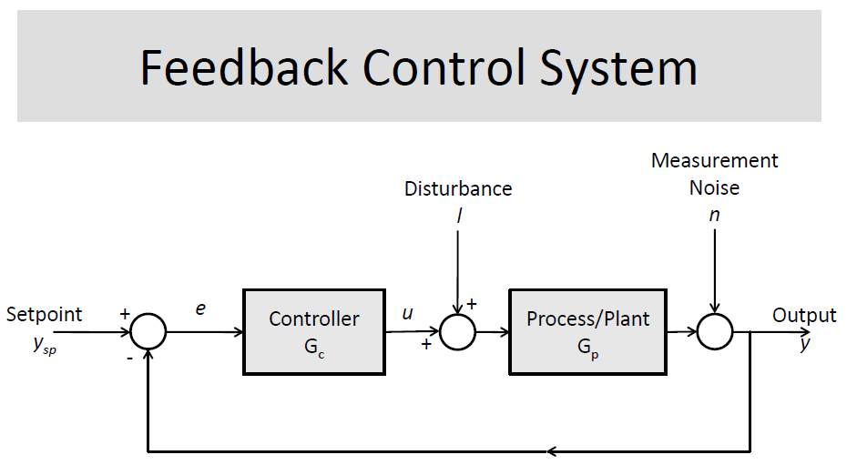

Slide 29
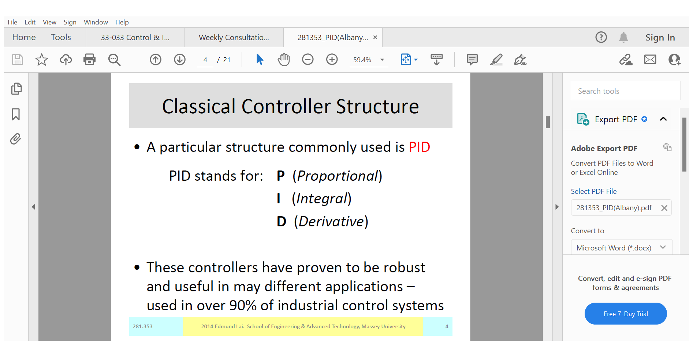

Slide 30
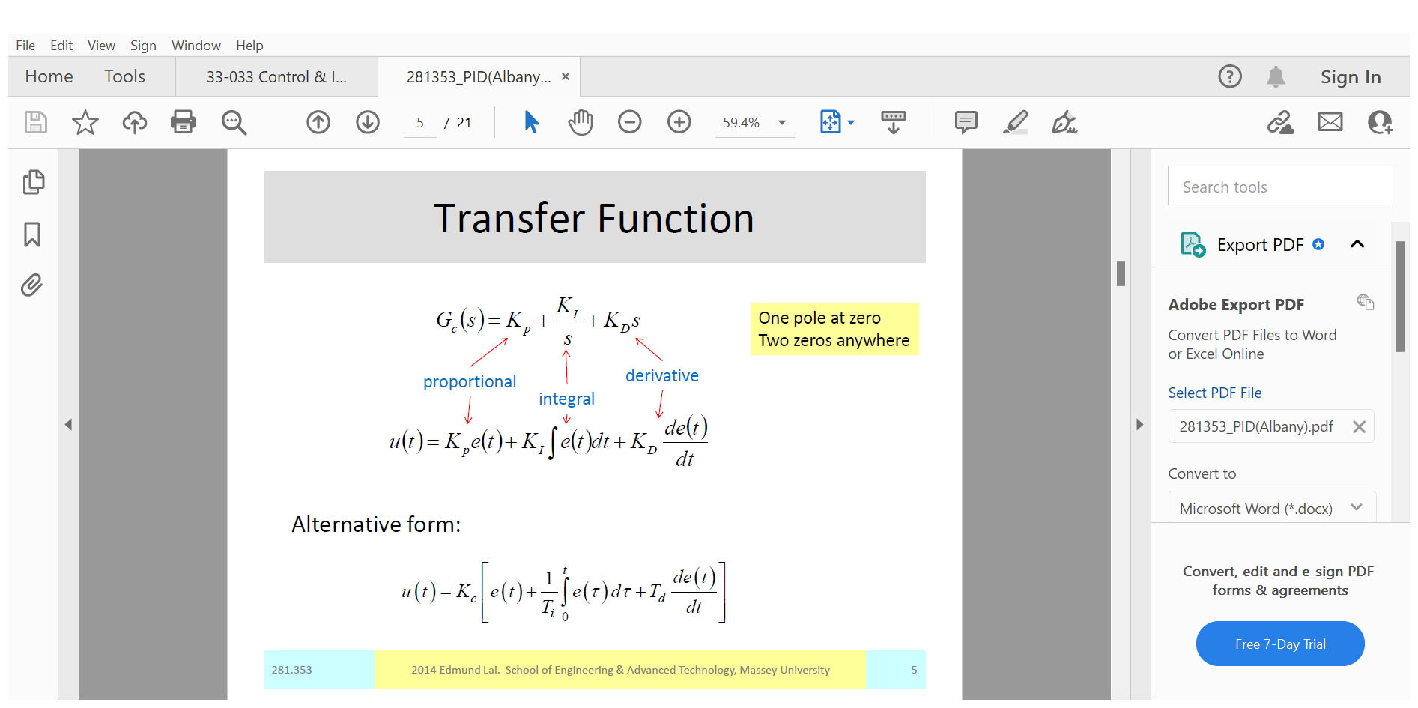

Slide 31
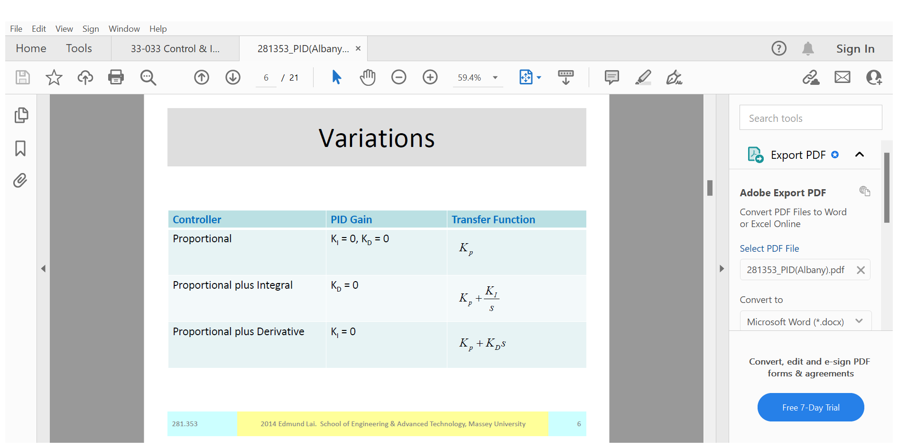

Slide 32
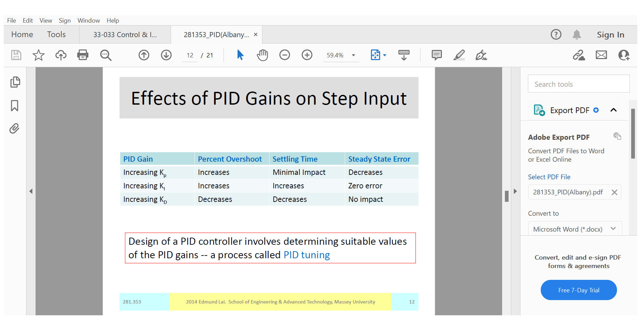

Slide 33
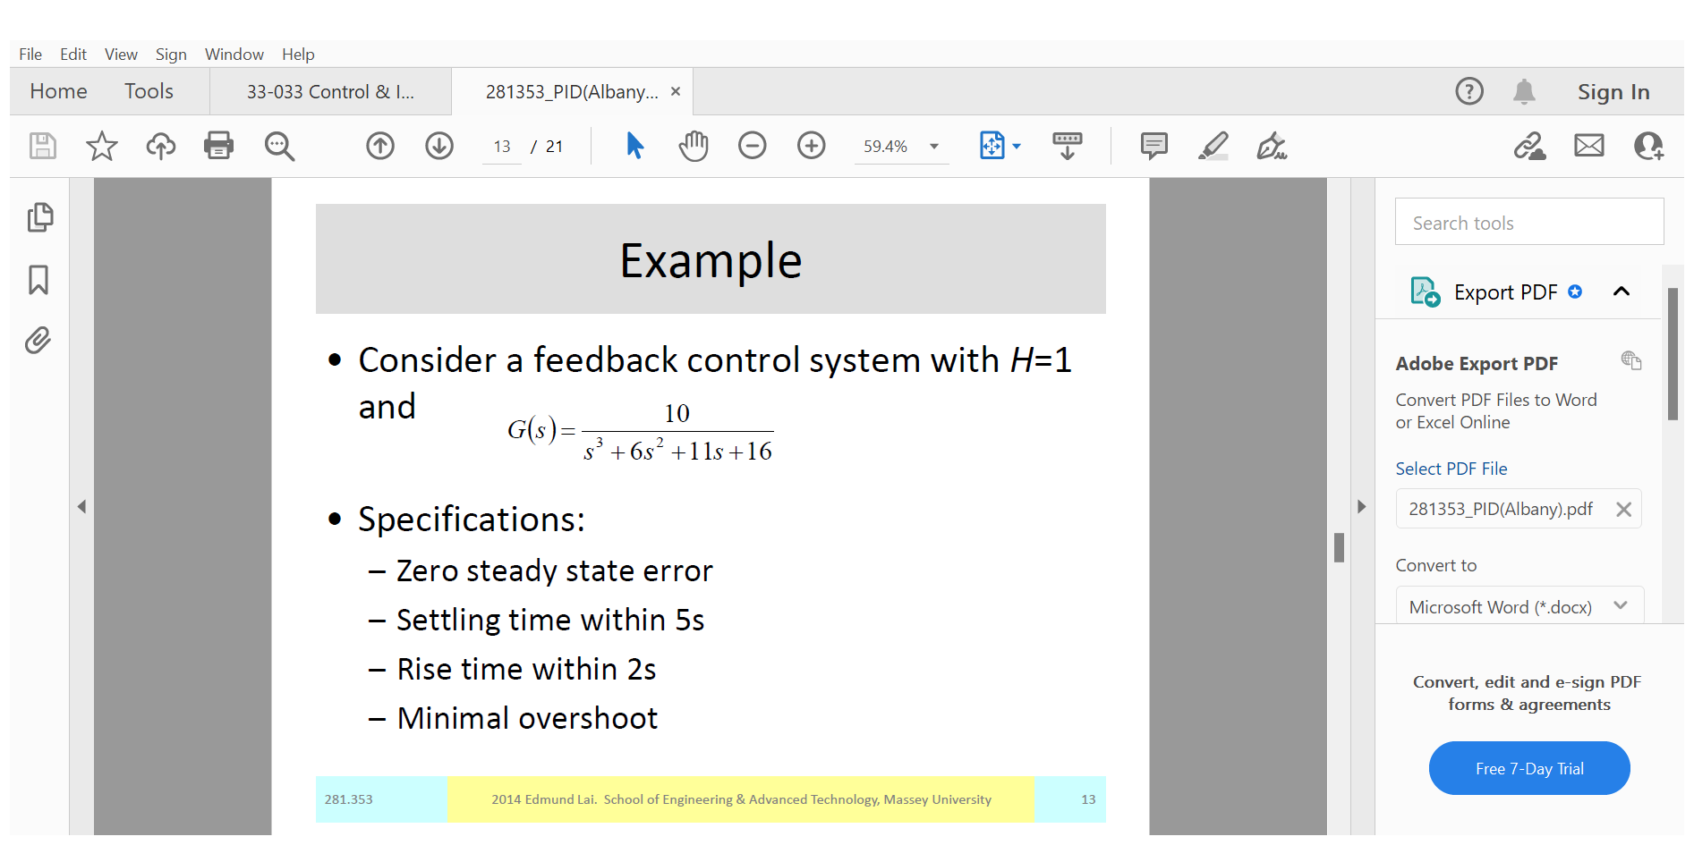

Slide 34
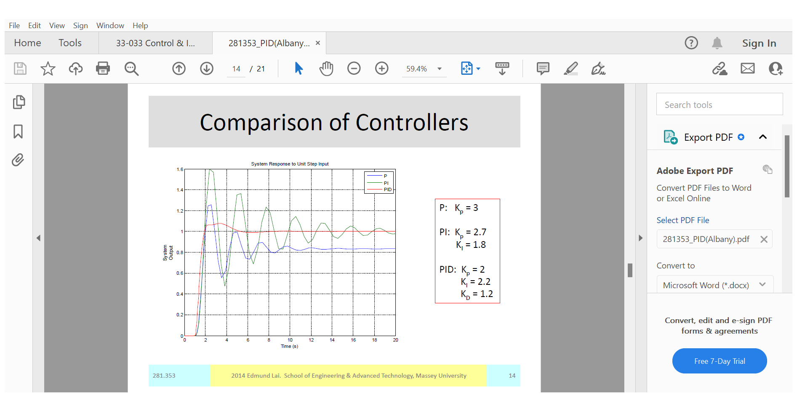

Slide 35
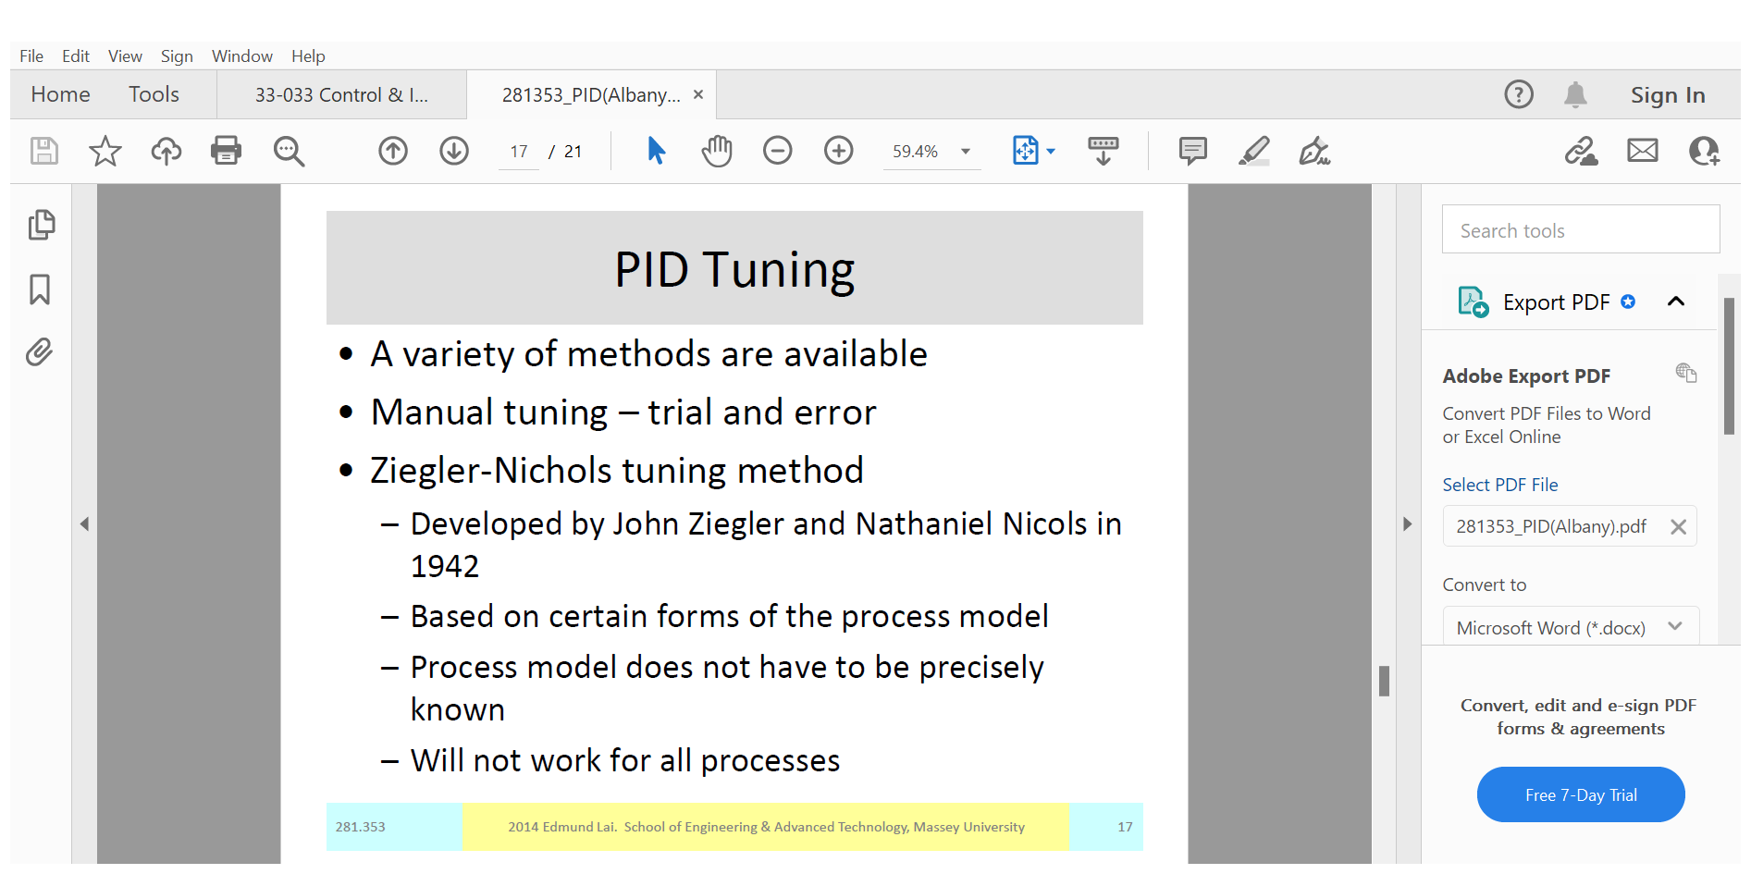

Slide 36
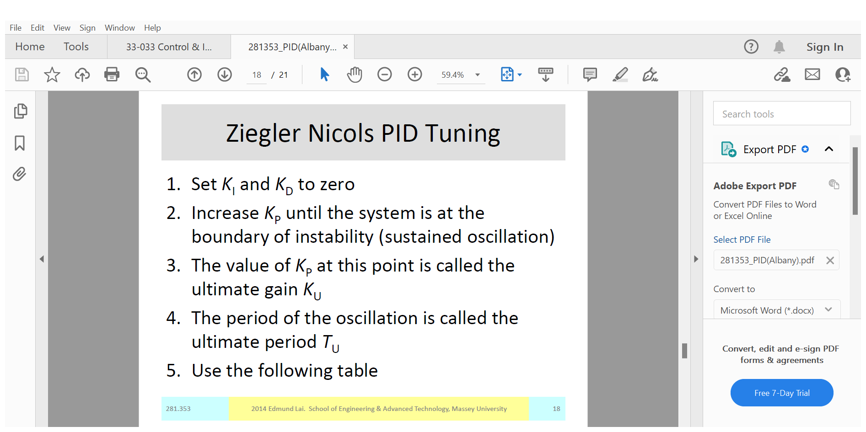

Slide 37
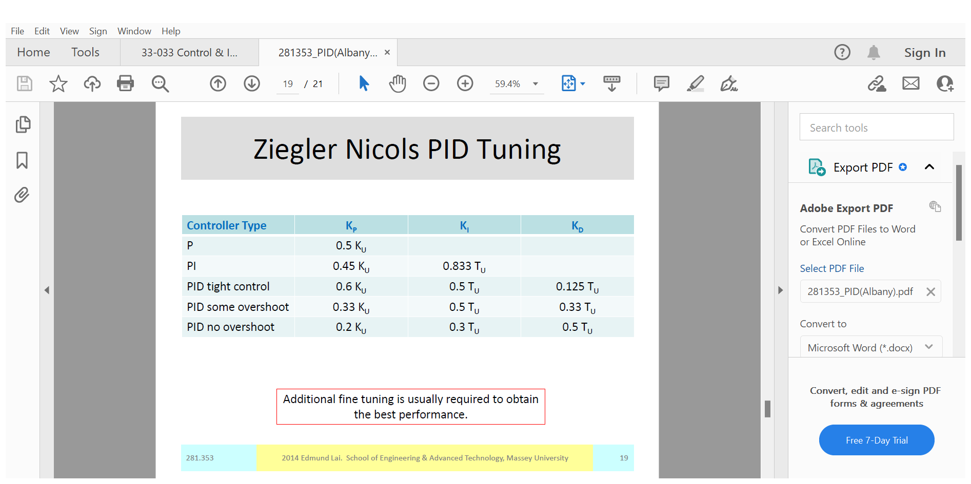

Slide 38
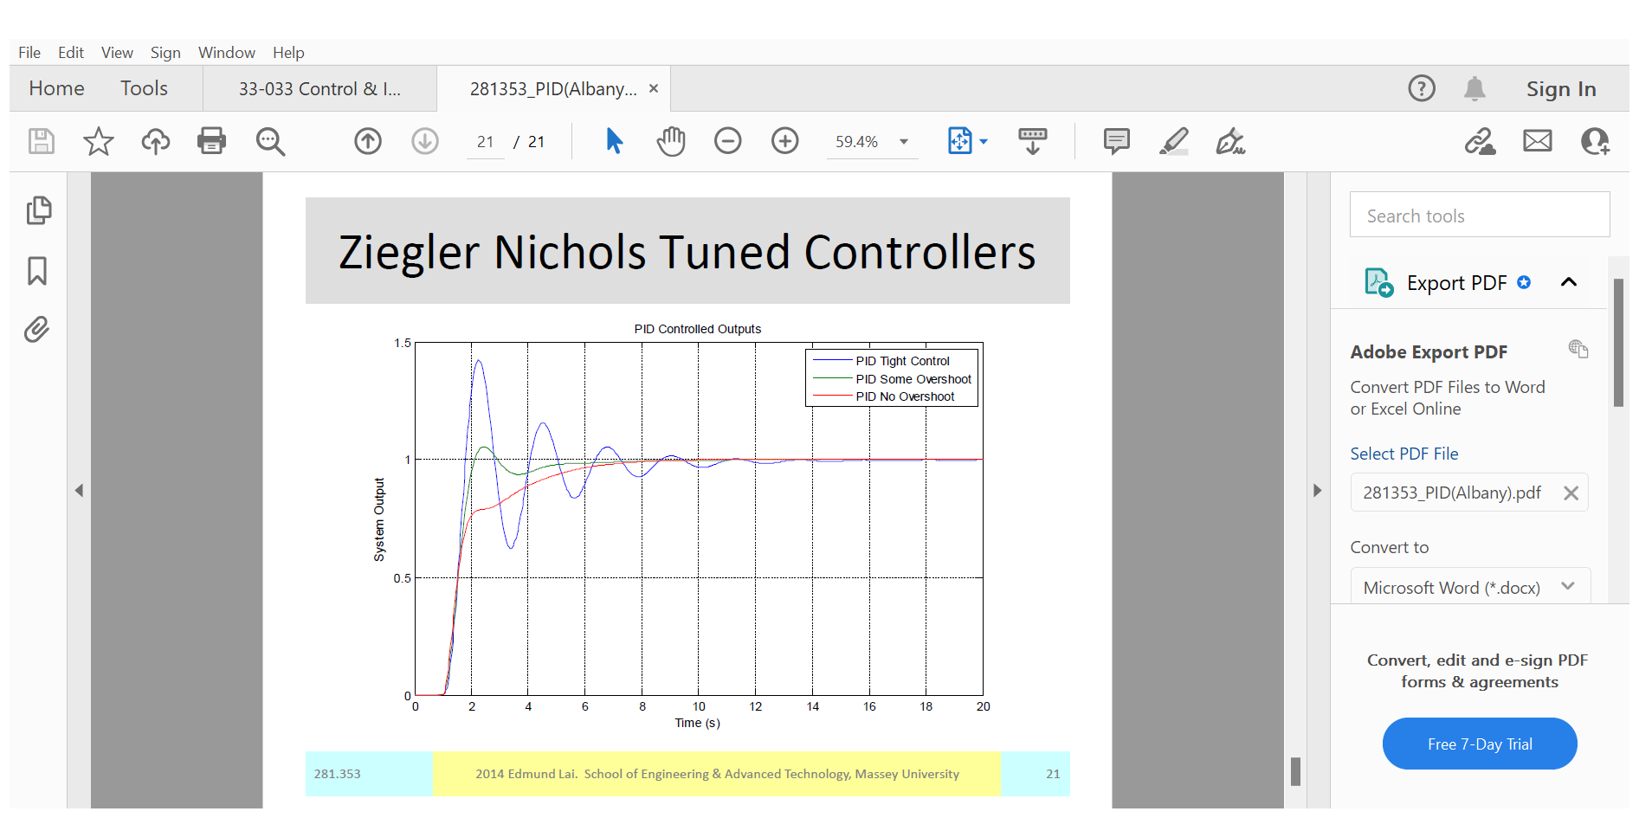

Slide 39
Mathematical models for systems
Mathematical models for systems is important to understand the behavior of them. The model is a replica of the relationships between the input and output or inputs and outputs. The actual relationship that exist between the input and output of a system have been replaced by mathematical expressions.
Voltage
Speed
Electric Motor
V
ω
Approximately,
ω
Model >>
V
Or, ω = GV
G

Slide 40
Dynamics of Electrical motor
Voltage
i_{a}
Speed
Electrical part
Mechanical part
V
ω
Electric circuit equation:
V = E_{b} + R_{a}i_{a} + L_{a} di_{a}/dt
Back e.m.f. equation: E_{b} = Kω
Torque equation: T_{m} = Ki_{a}
Mechanical equation: T_{m} = T_{l} + Bω + J dω/dt
-
T_{l}
V
i_{a}
T_{m}
ω
+
1
1
K
R_{a} + sL_{a}
+
B + sJ
-
E_{b}
K

Slide 41
Operations on Blocks
1. Cascading blocks
S_{i}
S_{o}
S_{i}
S_{o}
G₁
G₂
G₁G₂
2. Elimination of a forward loop
S_{i}
S_{o}
S_{i}
S_{o}
G₁
G₁ G₂
G₂

Slide 42
3. Elimination of a feedback loop
S_{i}
S_{o}
S_{i}
G
S_{o}
G
1
GH
H
4. Moving a take-off point from an input to an output of a block
S_{i}
S_{o}
S_{i}
S_{o}
G
G
S_{i}
1/G
S_{i}

Slide 43
5. Moving a take-off point to a block ahead
S_{i}
S_{o}
S_{i}
S_{o}
G
G
S_{o}
S_{o}
G
6. Switching blocks
S_{o}
S_{i}
S_{o}
S_{i}
G
1/H
H
1/G

Slide 44
Transfer function of DC motor
-
T_{l}
i_{a}
T_{m}
ω
V
+
1
1
K
R_{a} + sL_{a}
+
B + sJ
-
E_{b}
K
;τ_{a} = L_{a}/R_{a}
τ_{m}= J/B

Slide 45
TRANSFER FUNCTION (T.F.)
T.F. which describes the dynamic behavior of the system is defined as the ratio of the Laplace transform of the output variable to the Laplace transform of the input variable, with all initial conditions assumed to be zero.
How to get T.F.?
Obtain the mathematical (differential) equation describing the relationship between input and output or inputs and outputs.
Usually the equations are dictated by certain laws or principles. For example, for mechanical system it is Newton’s law of motion. For electrical system it is Kirchhoff’s laws etc.

Slide 46
Modeling in State Space
Modern Control Theory (MCT) versus Conventional Control Theory (CCT)
1. MCT is applicable to Multiple-Input-Multiple-Output (MIMO) system, which may be linear or non-linear, time-invariant or time varying. CCT is only applicable to Linear Time Invariant (LTI) Single Input Single Output (SISO) system.
2. MCT is essentially a time domain approach while CCT is a complex frequency- domain approach.
A few definitions:
State: The state of a dynamic system is the smallest set of variables (called state variables) such that the knowledge of these variables at t = t_{o}, together with the knowledge of the input for t >= t_{o}, completely determines the behavior of the system for any time t >= t_{o}.

Slide 47
State variables: The state variables of a dynamic system are the variables making up the smallest set of variables that determine the state of the dynamic systems.
A set of n simultaneous, first order differential equations with n variables, where the n variables are to be solved are the state variables.
The state variables need not be physically measurable or observable quantities.
State vector: If n state variables are needed to completely describe the behavior of a given system, then these n state variables can be considered the n components of a vector x. Such a vector is called a state vector.
State space: The n-dimensional vector space whose coordinate axes consists of the x₁ axis, x₂ axis, … x_{n} axis where x₁, x₂ … x_{n} are state variables, is called a state space. Any state can be represented by a point in the state space.
State-space equations: Three types of variables are involved in the modeling of dynamic system: input variables, output variables and state variables.

Slide 48
Output equations: The algebraic equations that expresses the output variables of a system as linear combinations of the state variables and the inputs.
A system is represented in state space by the following equations:
x = Ax + Bu
y = Cx + Du
x = state vector, y = output vector, u = input vector, A = system matrix, B = input matrix, C = output matrix, D = feedforward matrix.

Slide 49
State-space representation of DC motor
L_{a} di_{a}/dt = - R_{a}i_{a} – K ω + V
J dω/dt = Ki_{a} - Bω - T_{l}

Slide 50
How to get T.F. From State-space model
x = Ax + Bu y = Cx + Du
Taking Laplace transformation, we get
So, the T.F. is

Slide 51
Linearity:
For a linear system the Principle of Superposition is valid
If input F₁ produces response x₁ and Input F₂ produces response x₂
Then input (F₁ + F₂) must produce response (x₁ + x₂).
Law of proportionality
If input F₁ produces response x₁ then Input aF₁ must produce a response ax₁
Most of the practical systems are non-linear.

